Slide 1
Cooties
Jin Yan
Ryuta Oshikiri
Qingru Shen

Slide 2
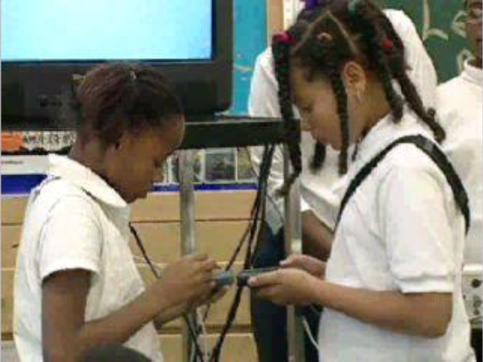
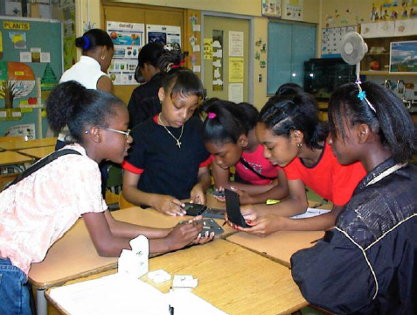
What is Cooties?
Application to teach spread of infection
Interaction between student
Better way to teach about disease

Slide 3
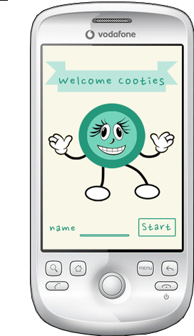
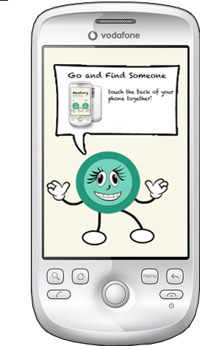
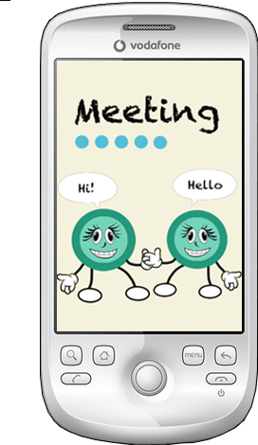
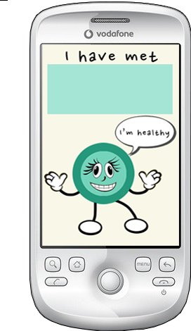
Status Report
We are able to store user info
Interface design
Some NFC read functionality

Slide 4
The Figurative Wall
NFC is kind of tough
Updating the network of all user states
Developing a platform for different types of disease
Wi-fi location based infection

